Slide 1
Pricing the Countries

Slide 2
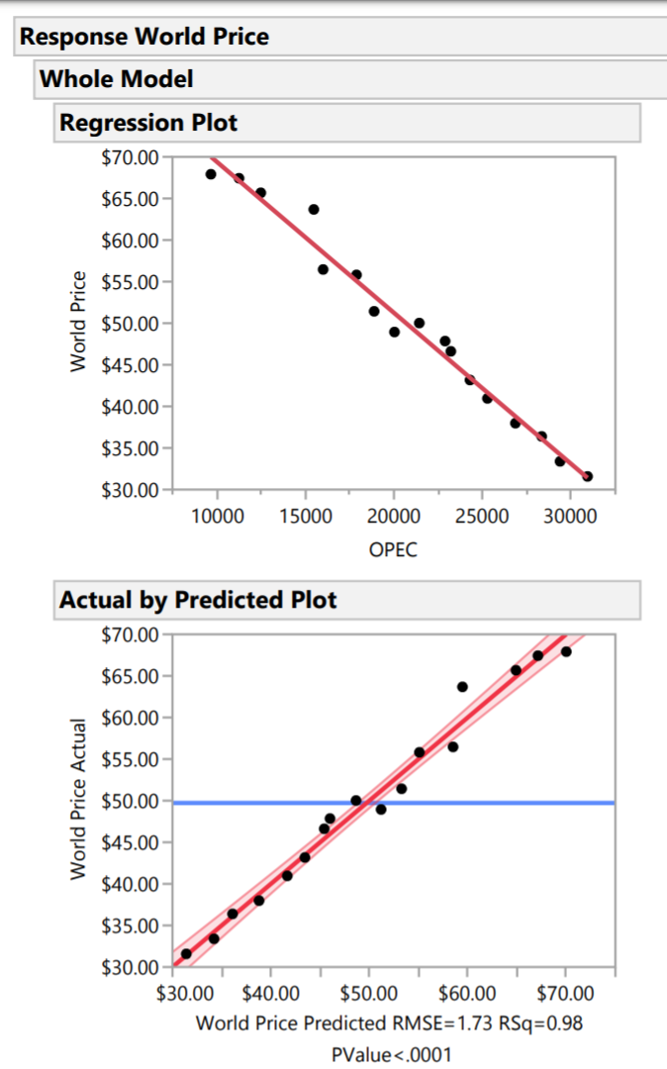
Demand curve
I fit a linear regression model to investigate the standard error of the slope and intercept estimates.

Slide 3
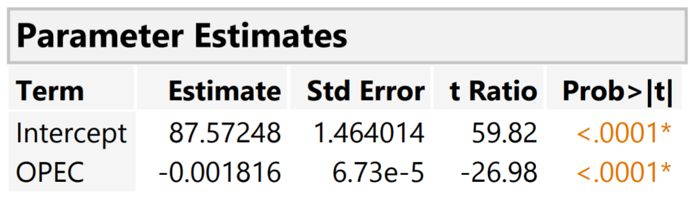
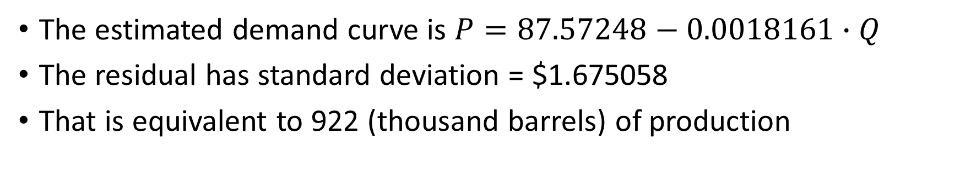
Demand curve
The estimated demand curve is $P=87.57248−0.0018161∙Q$
The residual has standard deviation = $1.675058
That is equivalent to 922 (thousand barrels) of production

Slide 4
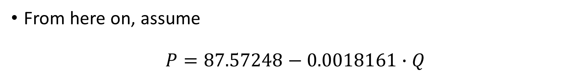
From here on, assume
$$P=87.57248−0.0018161∙Q$$

Slide 5
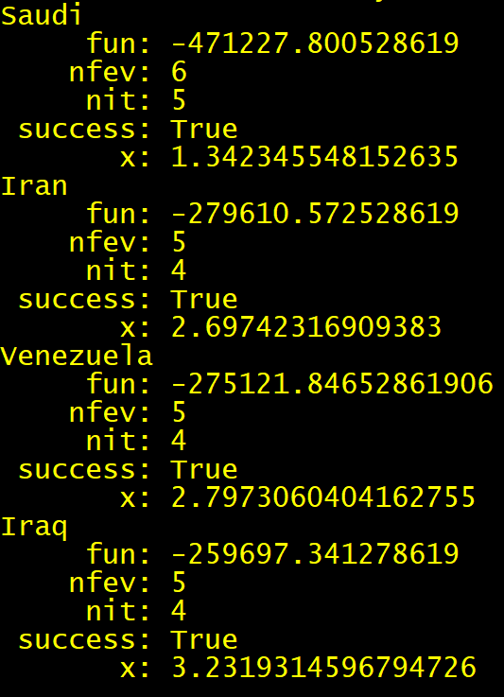
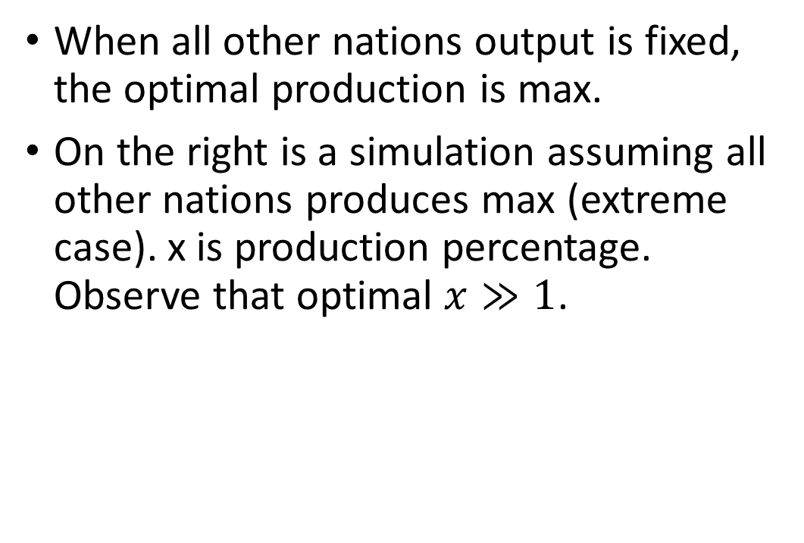
Be selfish = maximize production
When all other nations output is fixed, the optimal production is max.
On the right is a simulation assuming all other nations produces max (extreme case). x is production percentage. Observe that optimal $x≫1$.

Slide 6
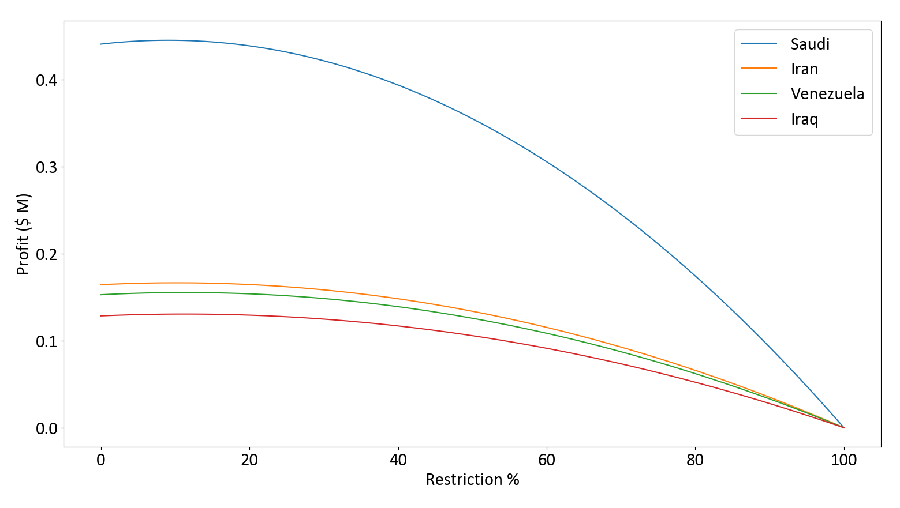
Be nice: assuming every nation restricts by equal percentage
B

Slide 7
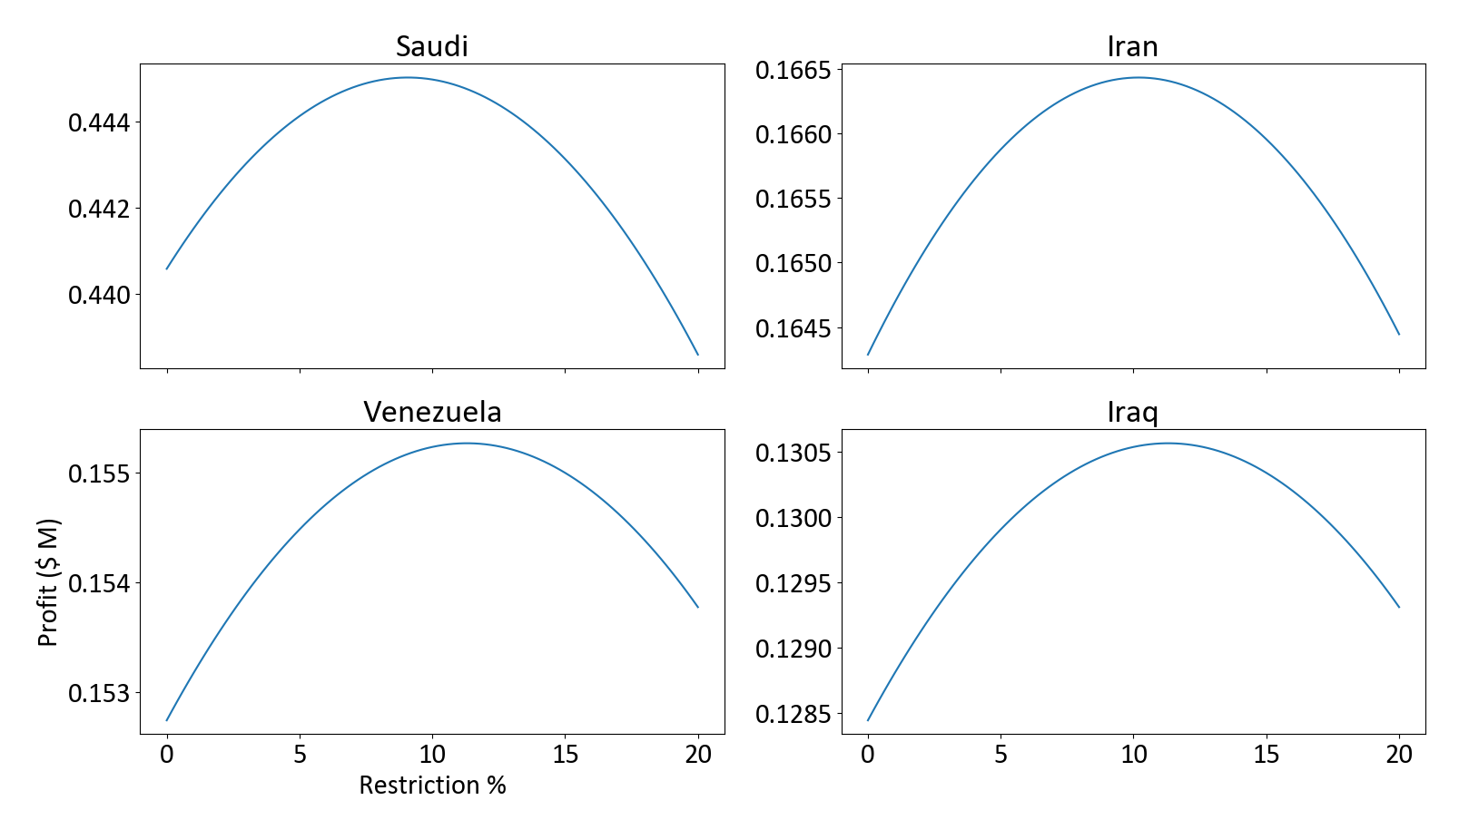
Be nice: assuming every nation restricts by equal percentage
B

Slide 8
Restrict 9.07633%? (Saudi max profit)
B

Slide 9
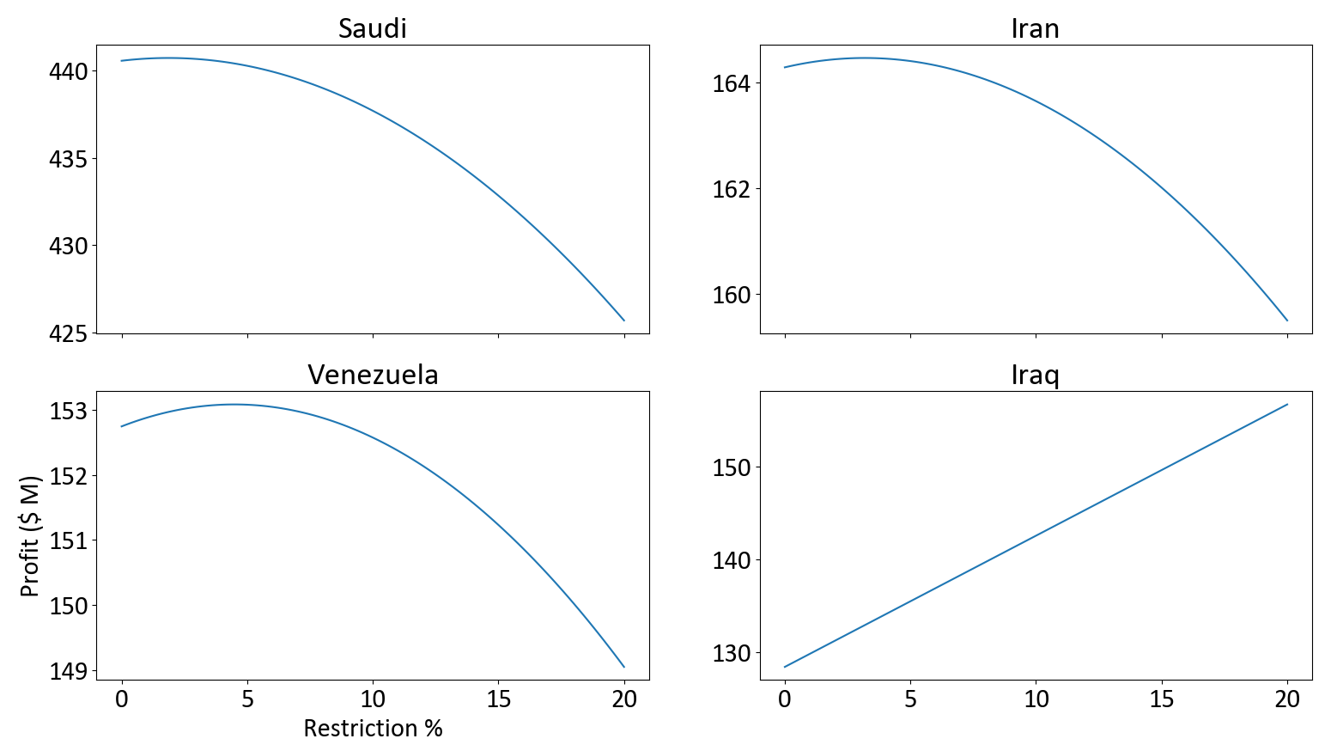
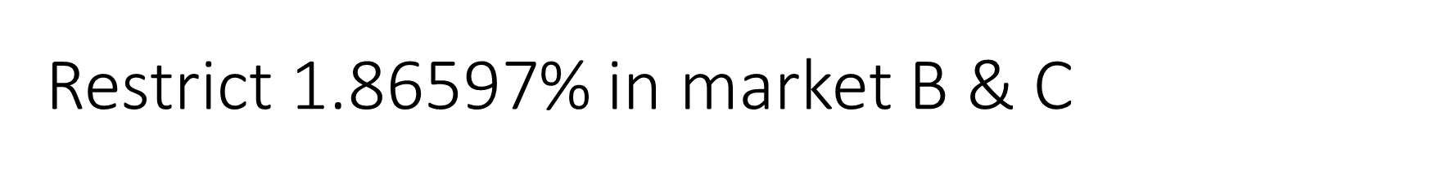
Restrict 1.86$\text{597}$% in market B & C
B

Slide 10

Conclusion
Nations will restrict by x%, where
$0≤x≤9\text{.07633}$ in market A
$0≤x≤\text{1.86}\text{597}$ in market B & C

Slide 11
Next topic

Slide 12
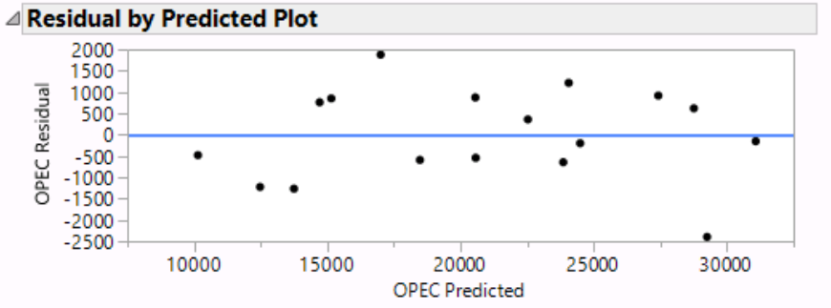
Backing out OPEC production
Use world output to estimate OPEC output.
Standard deviation = 1079 (thousand barrels)
For reference: Iraq 9% restriction = 333. Impossible to convict!
Saudi 9% restriction = 1080. Almost impossible to convict!

Slide 13
Next topic

Slide 14
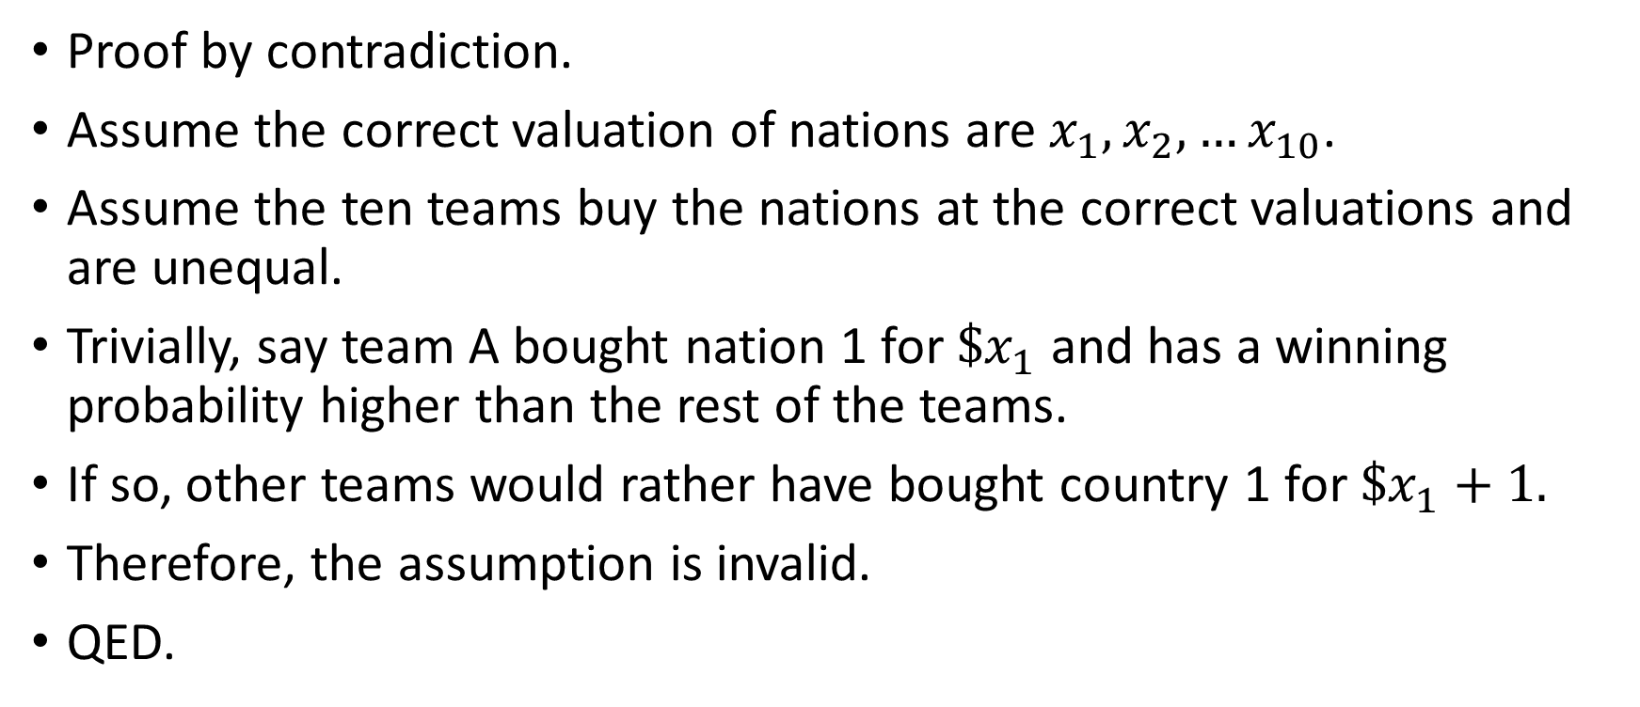
After auction, everyone is supposed to be equal
Proof by contradiction.
Assume the correct valuation of nations are$x_{1}, x_{2}, …x_{10}$.
Assume the ten teams buy the nations at the correct valuations and are unequal.
Trivially, say team A bought nation 1 for ${\$x}_{1}$ and has a winning probability higher than the rest of the teams.
If so, other teams would rather have bought country 1 for ${\$x}_{1}+1.$
Therefore, the assumption is invalid.
QED.

Slide 15
Next topic

Slide 16
Worst country = $100M
Imagine we go into the auction, and do not bid.
The rest of the teams got 9 countries.
The 10th country left for us, is, in the worst case, the worst country.
We can buy it for $100M (initial bidding price).
Therefore, the valuation of the worst country cannot be higher than$100M.

Slide 17
Worst country = $100M
As a consequence, after we calculate the expected overall profit for each nation, we should offset these numbers until the worst nation is $100M.
For example: 220M 210M 240M 300M should become 110M 100M 130M 190M.

Slide 18
Next topic

Slide 19
Expected profit under various scenarios
Scenario A: war of all against all everyone maximizes.
Scenario B: nice cooperation everyone starts restricting by 9%, but maximizes from turn 11.
Scenario C: nobody notices me I always maximizes, while everyone else always restricts 9%.

Slide 20
Expected profit under various scenarios
Saudi | Iran | Venezuela | Iraq
Scenario A: war of all against all
5177 | 1930 | 1795 | 1509
Scenario B: nice cooperation
5221 | 1952 | 1819 | 1530
Scenario B: nice cooperation in market B & C where Iraq is non-strategic
5178 | 1932 | 1797 | /
Scenario C: nobody notices me (UNREALISTIC)
5502 | 2128 | 1985 | 1675
(Unit:$ M, sum over 13 turns, w/ 12th 13th diminished)

Slide 21
Nation valuation under various scenarios
Saudi | Iran | Venezuela | Iraq
Scenario A: war of all against all
3768 | 521 | 386 | 100
Scenario B: nice cooperation
3791 | 522 | 389 | 100
Scenario B: nice cooperation in market B & C where Iraq is non-strategic
3748 | 502 | 367 | /

Slide 22
Next topic

Slide 23
Retaliation effectiveness
When nation 1 offends, nation 2 3 4 retaliates nation 1.
How many turns to they have to promise to retaliate so that nation 1 would not offend?

Slide 24
Retaliation effectiveness
When nation 1 offends, nation 2 3 4 retaliates nation 1.
How many turns to they have to promise to retaliate so that nation 1 would not offend?
In market A, if Saudi offends, Saudi gains 20.69 M If the rest three retaliates, Saudi loses 25.12 M
So retaliation works, and 1 period retaliation is enough.

Slide 25
Recap on the assumptions
All nations restrict at equal percentage.
The underlying demand function is as regressed.

Slide 26
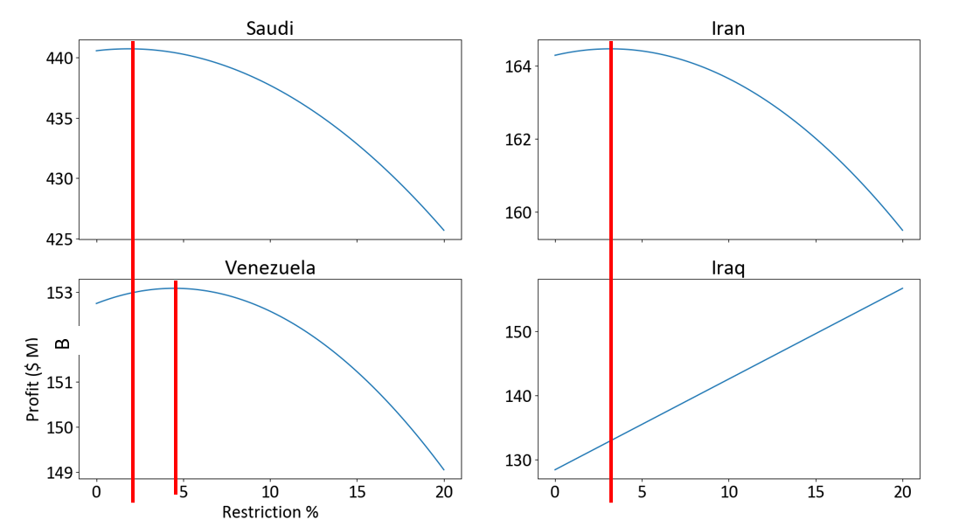
Recap on the assumptions
All nations restrict at equal percentage.
The underlying demand function is as regressed.
Future work:
Assumption 1 should be dropped in market B & C, since the rest of the two countries may want to restrict more.

Slide 27
Footnote
Saudi | Iran | Venezuela | Iraq
Scenario A: war of all against all
5177 | 1930 | 1795 | 1509
Scenario B: nice cooperation
5221 | 1952 | 1819 | 1530
Scenario B: nice cooperation in market B & C where Iraq is non-strategic
5178 | 1932 | 1797 | /
It seems market B and C might as well always max out.
Only market A has game going on.

Slide 28
Thank you for viewing

